Slide 1
EVENT ANALYSIS
Original From:
Object-Oriented Systems Analysis And Design With UML
By Robert V. Stumpf
And
Lavette C. Teague
Expanded by: Ferreiras.

Slide 2
What is an event?
An occurrence, something that happens, at a specific time and place that can be describe and is worth (have merit of be) remembering.

Slide 3
For us (as analyst), what thing is a event?
When defining system requirements, we are primarily interested in events at the level of the system as a whole. For our purposes, we will refer to these system-level events as business events or, simply, “events”.

Slide 4
For us (as analyst), what thing is a event?
So, an event for us is any identifiable occurrence that has significance for the system, such that :
 Takes place at a specific time;
 Trigger a predetermined response from the system;
 Can Occur independently of other event;
 Information may be exchanged;
 Can be described; And,
 Should be remembered by the system.
 Can be external, internal or temporal;

Slide 5
Example of event for us
Customer claim a reservation
Customer make a reservation acknowledgement
System store a reservation denial
Customer change a address
Customer do a payment
Time to produce week summary reports
...

Slide 6
For us, an event
Drive or trigger all processing that a system does, so listing events and analyzing them makes sense when you need to define system requirements by identifying use cases.

Slide 7
External event
 External event, is an event which occurs outside the system boundary. The incoming information must also contain specific data about the event in order for the system to respond appropriately.

Slide 8
External event description
Is a complete sentence in the active voice. Examples are:
 Customer makes a withdrawal from a bank account;
 Passenger requests an airline reservation;
 Student drops a class.

Slide 9
External event description
Note that when an external event is named, the subject of the sentence will refer to a person, organization or system in the environment, and the predicate of the sentence often refers to a system input ( the message reporting the essential information about the event). Sometimes the predicate may refer instead to the desired system output.

Slide 10

External event, components
Event as a whole
System
system input (stimulus)
system output (response)
Black Box

Slide 11

External event, Example
 External event: “Guest registers at a hotel”.
Hotel Registration System automatically reads visitor's data from his or her ID document
A client workstation is installed at the hotel front desk. Each workstation is equipped with the document reader VDR 1, and allows the receptionist to scan the visitor's passport and enter additional data such as the hotel name, the room number, the checkin date, etc. The hotel application supports both online and offline operation. The system functions can be fully customized. The workflow can include actions such as black list searches, filtering according to personal attributes (such as sex, nationality, age range), special notification etc. The server can generate reports based on the submitted information from the client stations, such as average number of hotel visits per day, number of visitors from a specific country etc.
Hotel
Registration
System
system input
system output
Guest

Slide 12
Internal event, example
 internal event, is an event which occurs inside the system boundary.
 Example: When the quantity of an item of inventory falls below the reorder point.

Slide 13
Temporal event, example
 Temporal event, is an event which occurs at a prespecified time.
 Example: Every Friday afternoon it is time to produce employees paycheck

Slide 14
Messages
The only way the system can learn about what takes place on the outside is by receiving messages which contain the essential information about what has occurred.

Slide 15
Messages
The only way the system can learn about what takes place on the outside is by receiving messages which contain the essential information about what has occurred.

Slide 16
Messages
The only way the outside world can perceive the system’s responses is through messages coming from inside the system.

Slide 17
Messages
Like all information flows, the messages may be classified as either:
 Event flows; or,
 Data flows

Slide 18
Event flow
Is a signal or message which notifies the recipient that a particular event has occurred; Is an information flow which contains no application-specific data.

Slide 19
Incoming Event flow
An incoming event flow merely notifies the system that a specific event has occurred and triggers the system to respond. Any data essential to the system’s response is already stored inside the system.

Slide 20
Incoming Event flow
Temporal event flow, for example, always generate event flows:
 First-of-the-Month;
 Time-to-Produce-Account-Statement;

Slide 21
Outgoing Event flow
Initiates an action in the environment or report to the environment that the system has completed its response. For example, messages such as:
 Successfully Completed;
 Unable to Complete;
 Fatal error occurred.

Slide 22
Data flow
A data flow contain application-specific data elements with specific values which describe details of the event. For example, the Withdrawal Request event might consist of:
 accountNumber;
 withdrawalDate; and,
 withdrawalAmount.

Slide 23
Data flow
An incoming data flow serves two purposes:
 Its arrival triggers the system to respond;
 The flow contains the data essential for the system to produce the required response or, if some of the information is already stored in the system, the flow contains the additional essential data.

Slide 24
Data flow
An outgoing data flow transmits the system’s response to the environment. It may be as simple as one or two data items or as complex as an elaborate report.

Slide 25
Recognizing events
In order to respond to an event, the system or some object within it must be able to recognize that the event has occurred. The occurrence of an event generates an event flow.

Slide 26
Recognizing events
The basic pattern of operation of an event-driven system is as follows:
 The system does nothing until triggered by an event; It sits and waits for an event to occur;
 When an event occurs, the system responds as completely as possible;
 After the response is finished, the system continues to wait until something else happens.

Slide 27

Recognizing events
For example, a vending machine like this

Slide 28
Recognizing events
 Event: Someone drops some money in the coin slot;
 Event flow: The signal from the coin slot;
 Two pieces of data: Specification of the beverage and the amount paid ⬇
Pressing the beverage selection button and the coin slot senses the amount paid;
With this information, the machine can respond appropriately.

Slide 29
Recognizing events
The system may recognize either directly or indirectly that a event has occurred:
 Direct recognition: Sends an information flow to the system. For example, The arrival of a withdrawal request informs the bank transaction processing system that a customer wishes to make a withdrawal.

Slide 30
Recognizing events
 Indirect recognition: Requires the system to infer the occurrence of an event from the inputs it receives. For example, data from the environment may be compared with internally stored values, or the system may calculate or simulate what is going on outside.

Slide 31
Identifying Actors
An actor is a person, organization, or system which interacts with a system. An actor may generate a system input or receive a system output.

Slide 32
Identifying Actors
To identify an actor:
 Find out which people, organizations, or systems in the environment provide each system input or receive each output;
 Give the actor a name ( A noun or noun phrase describing the actor ).

Slide 33

System input, Output
Are the only means of communication between the system and its environment.
The
system
system input
system output

Slide 34
System input, Output
 Flows of data: Traditionally, the inputs and outputs are considered as flows of data, specified as messages.

Slide 35
System Input
Message or signals which report on occurrences in the environment of the system.
The message tells the system what it needs to know about an event, a stimulus to which the system must respond, but it is not the event itself.

Slide 36
System Input
How to identify a system input?
■ Finding out what information associated with an event is entering to the system;
■ Giving the input a name which describes the contained in the input.

Slide 37
System Input
For example:
■ Event: Student register for classes;
■ input name: Registration Request;
■ Information associated:
studentID, desiredSections, classID

Slide 38
System Output
The message produced by the system in responding to an event, but it is not the event itself.
 It is not always necessary for the system to produce an output when it responds to an event.

Slide 39
System Output
Predetermined message or signal produced when a specific input or combination of inputs is received by the system.

Slide 40
System Output
How to identify a system output?
■ Finding out what information associated with an event is leaving to the system;
■ Giving the output a name which describes the contained in the output.

Slide 41
System Output
For example:
■ Event: Produce University Class Schedule;
■ output name: University class schedule;
■ Information associated: period, year, departmentID, courseTitle, sectionNumber, maxSeats, meetingTime, meetingPlace, instructorID, instructorName

Slide 42
System Output
 Sometimes an event will result only in storing data within the system, producing no associated output as response of the to the input.

Slide 43
Action or response of the system
 It is true that the system must carry out an action or behavior to respond to an event, but the event is independent of the response. It occurs whether or not the system responds adequately.

Slide 44
An event is not:
 A system input;
 A system output;
 A action or response of the system;

Slide 45
Event Analysis
Event analysis identifies the events to which the system is expected to respond, names the inputs and outputs, and identifies the actors – those who interact with the system by providing inputs and receiving outputs.

Slide 46
Event Analysis
Event analysis views an information
processing system from the perspective of stimulus and response:
 The stimuli are system inputs;
 Responses are system outputs or the action of store data in the system’s internal memory.

Slide 47
Event Analysis
Business event analysis results in an event model, presented as an event table.
Event analysis treats the system as a black box and views it from a stimulus-response perspective:

Slide 48
Event analysis
Is interested in events at the level of actor-system as a whole:
The
system
system input
system output

Slide 49
Event analysis
Is a Event-Driven Approach that takes a stimulus-response perspective:
 The system does nothing until it is triggered by an event.
 When an event occurs, the system responds as completely as possible.
 After the response is complete, the system waits until another event occurs.

Slide 50
Event Analysis
Event analysis creates a system description by identifying:
The events to which the system is expected to respond
The incoming message (event flow or
data flow) associated with each event
The desired response
The actions or behaviors required to generate the response for each stimulus

Slide 51
Event analysis
 View the system in terms of events
 Helps to sequence and coordinate system’s behavior and to identify system responses which are independent of each other;

Slide 52
Event analysis
 Because events occur independently of each other, event analysis is a powerful technique for breaking up a large or complex system into small, manageable, cohesive, independent parts.

Slide 53
Event analysis
For example, Banking transactions at a ATM. A customer may ←
 Deposit funds;
 Withdraw funds; Or,
 Transfer funds
Each of these
transactions
may be regarded
as an event

Slide 54
Event analysis
 These transactions can occur independently, in any order.
 The customer initiates the transaction, provides the system with the necessary data and expects a predictable response.

Slide 55
Event analysis
 The system is organized to produce preplanned response to what happens outside it.
 An entire information processing system respond to a selected set of occurrences in the system’s environment.

Slide 56
Event analysis
 At any one time the analyst and user focus on small and manageable portion of the system;
 Stresses the need to identify and understand each of the situations in the environment to which the system must respond.

Slide 57
The event analysis
 Is a powerful technique for identifying what users expect a system to do;
 Initiates the analysis process and drives the development of the other models of the OOA;

Slide 58
Hints About Event Analysis
Ignore the technology of implementation , build an essential event model.
Model the system’s complete response, don’t split a single event into fragments.
Isolate individual events, don’t combine events if the system must wait in between them.

Slide 59
Events and Use Cases
For each event, the most important information to identify is the use case to which the system needs to respond. This information can be entered in an event table. Information in the event table documents important aspects of the event and the resulting use case.

Slide 60
Events and Use Cases
An event table includes rows and columns, representing events and their details, respectively. Each row in the table records information about one event and its use case. Each column in the table represents a key piece of information about that event and use case.

Slide 61
Event Table
Event Number | Event Description | System input | Actor providing input | System output | Actor receiving output
 |  | For external events, this is data entering the system; For temporal events, it is a definition of the point in time that triggers the system processing. | For an external event, is the source of the data entering the system | What output (if any) is produced by the system? | Get the output produced by the system.

Slide 62
Use Case
What the system does when the event occurs ( the reaction to the event) is the use case.

Slide 63
Use Case
For example:
REMEMBER: What the system does when the event occurs ( the reaction to the event) is the use case executed by the system.
Event: Customer place an order
Use Case: Create a new order
Event: Time to produce order summary reports
Use Case: Produce transaction summary reports
Event: Customer wants to check item availability
Use Case: Look up item availability

Slide 64
An example of event analysis
PUBLIC UNIVERSITY REGISTRATION SYSTEM
[ From page 82, Stumpf-Teague ]
A student records system for a public university.
Functionalities
The schedule of classes for each term is produced in advance of the pre registration date according to a timetable prepared by the Records Office. By a date contained in the timetable, each department in the university must submit a list of classes scheduled for the term in question. These lists are combined to forma a printed class schedule. The schedule is distributed free to each department office and to each professor; students must buy theirs at the bookstores.

Slide 65
An example of event analysis
During the pre registration period, students request the classes they would like to take, using a touch-tone telephone. Each class request contains the student’s identifier and the identifier of the class for which the student wishes to register. If that class is no available, the student may try to enroll in a different section of the same course or in another class. After a student has registered for as many classes as possible (up to the maximum number of units permitted), a class list is printed for that student. It shows the classes in which the student has been enrolled.
A class roster (class list), containing a list of the student’s names and identifiers, is printed for the professor teaching each class. The list is ordered alphabetically by the student’s last names.

Slide 66
Identify the Business Events
Event List for the Public University Registration System
External 1. Department submits class
schedule
Temporal 2. Time to produce university
class schedule
External 3. Student registers for classes
Temporal 4. Time to produce class roster

Slide 67

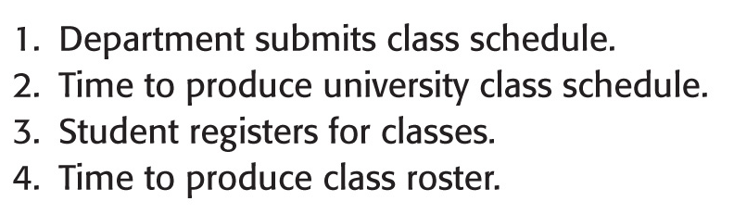
Event List
Event list for the university registration system

Slide 68
Identify the Actors,
Inputs, and Outputs
Who supplies system inputs?
Department submits a Department Class
Schedule.
Student supplies a list of desired classes
(a Registration Request).

Slide 69
Identify the Actors,
Inputs, and Outputs (continued)
Who receives system outputs?
Departments, Professors, and
Students receive the University
Class Schedule.
Student receives a Class List.
Professors receive Class Rosters.

Slide 70

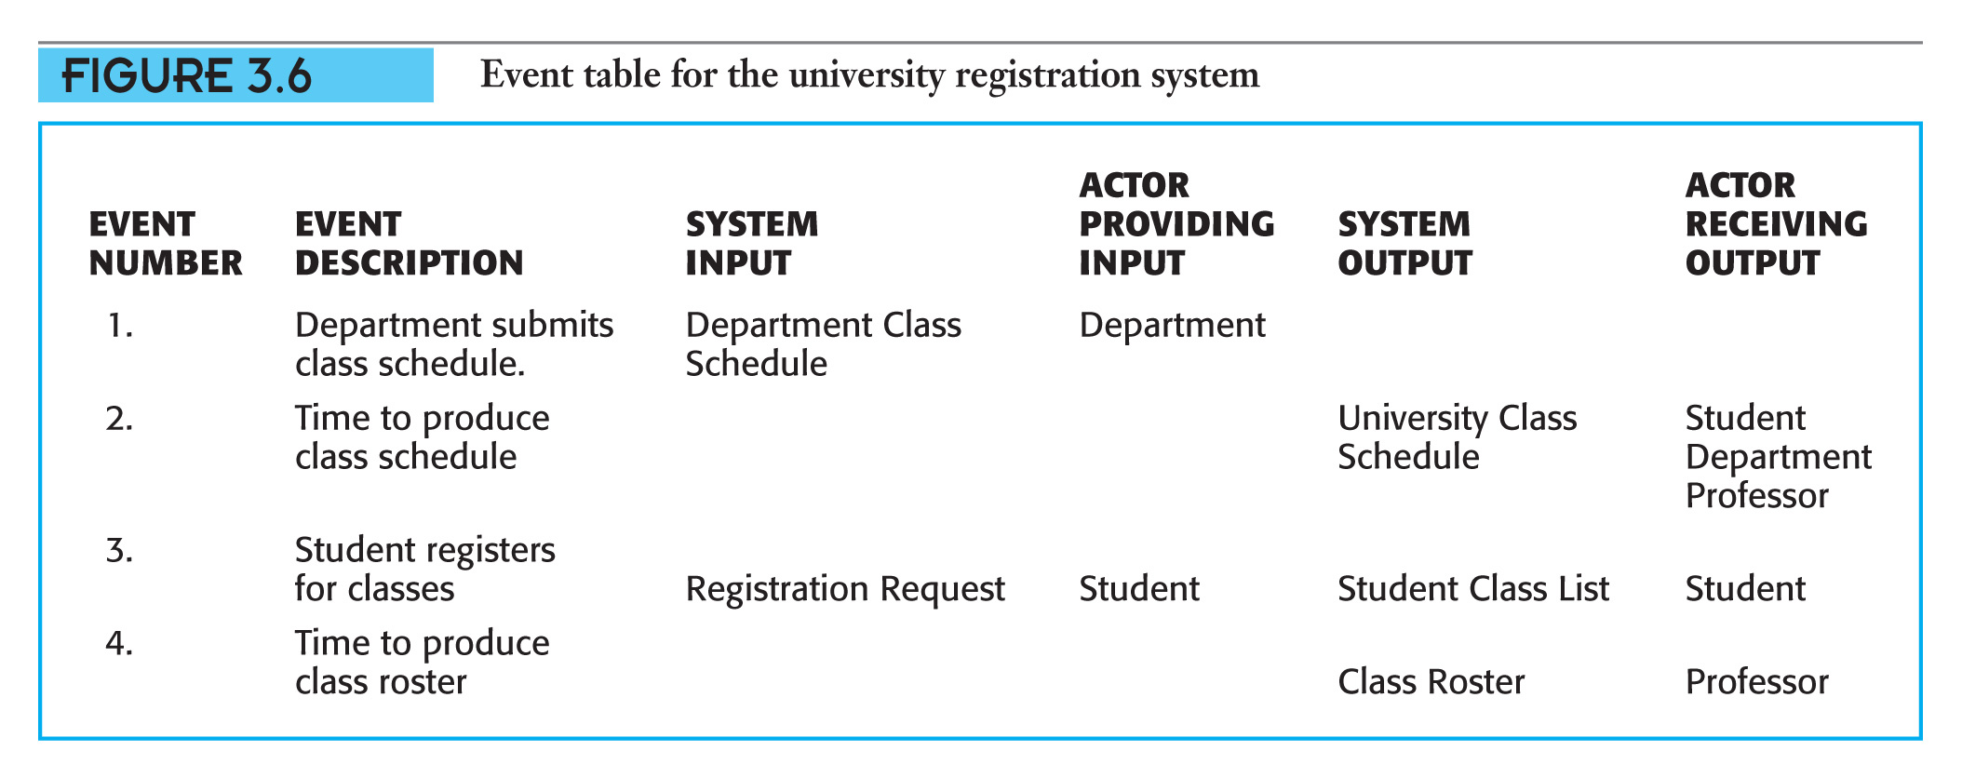
Event Table
.

Slide 71
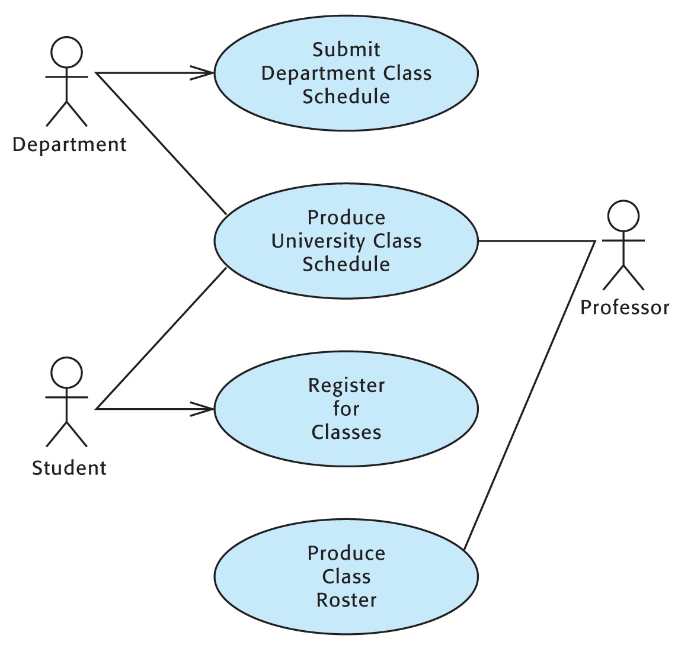

Use Case Diagram

Slide 72

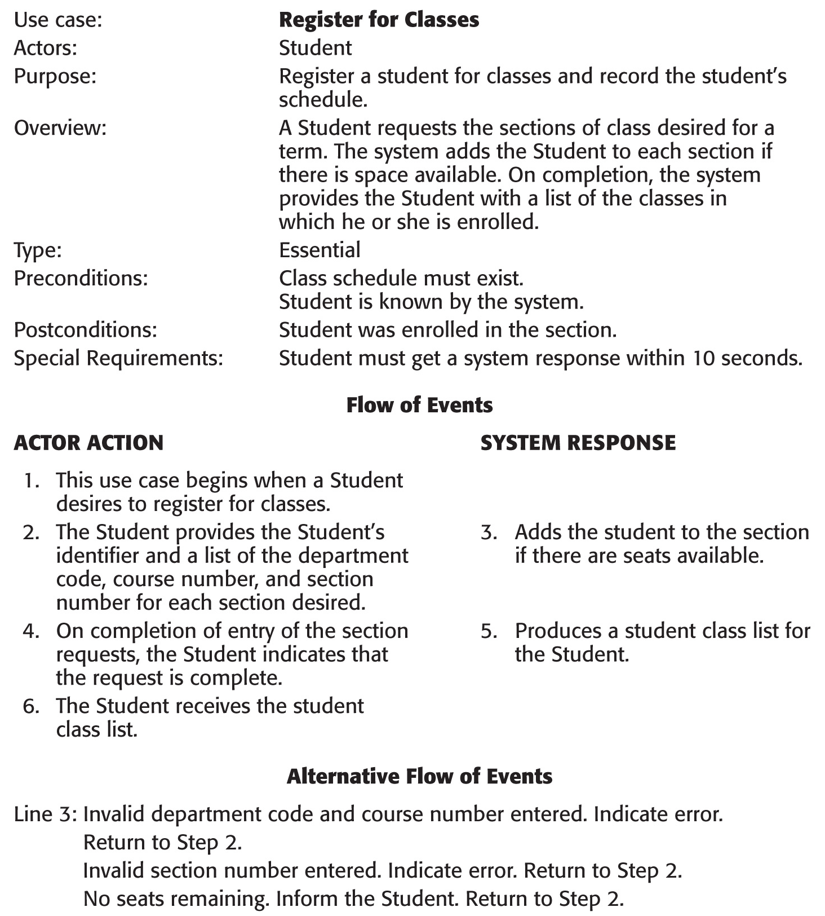
Use Case Narrative
.
Please, Use Case Description as established in this course.
FF

Slide 73

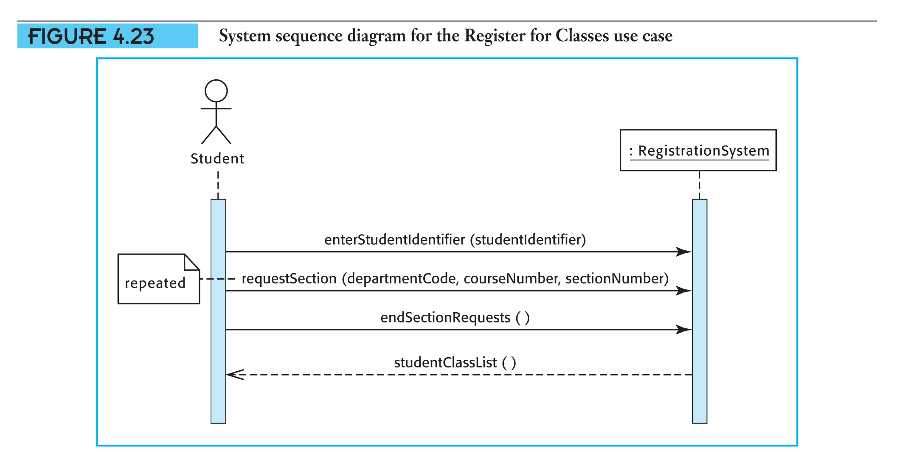
System Sequence Diagram

Slide 74

Bye

